Slide 1

Advanced Databases and Data Warehouses
Project presentation

Slide 2
Presentation of the Dataset
13 different attributes :
1) Alcohol 2) Malic acid
3) Ash 4) Alcalinity of ash
5) Magnesium 6) Total phenols
7) Flavanoids 8) Nonflavanoid phenols
9) Proanthocyanins 10)Color intensity
11)Hue 12)OD280/OD315 of diluted wines
13)Proline

Slide 3
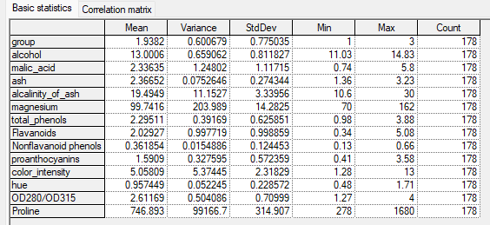
Basic statistics

Slide 4
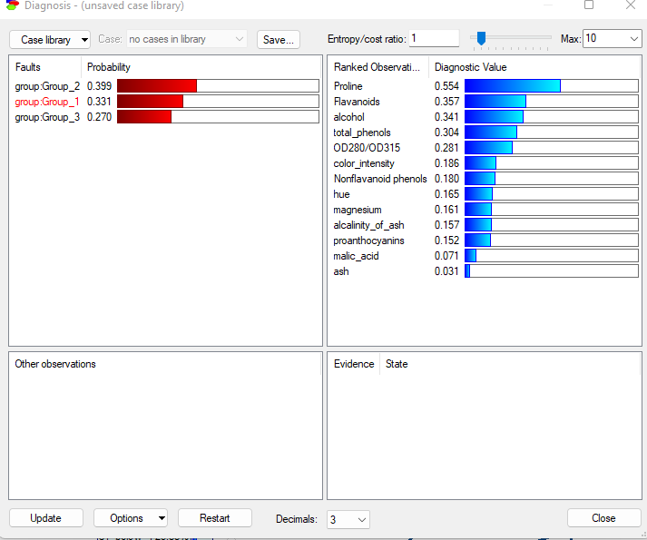
Influence of variables
Group 1:

Slide 5
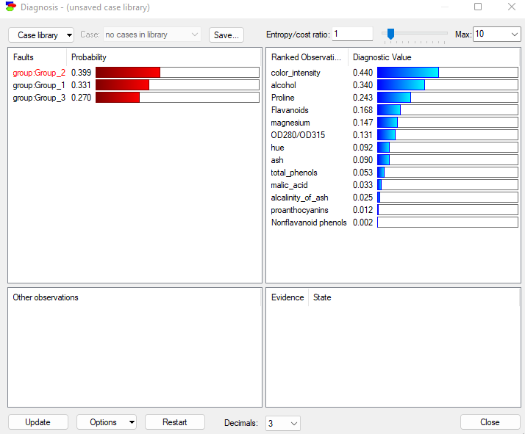
Group 2

Slide 6
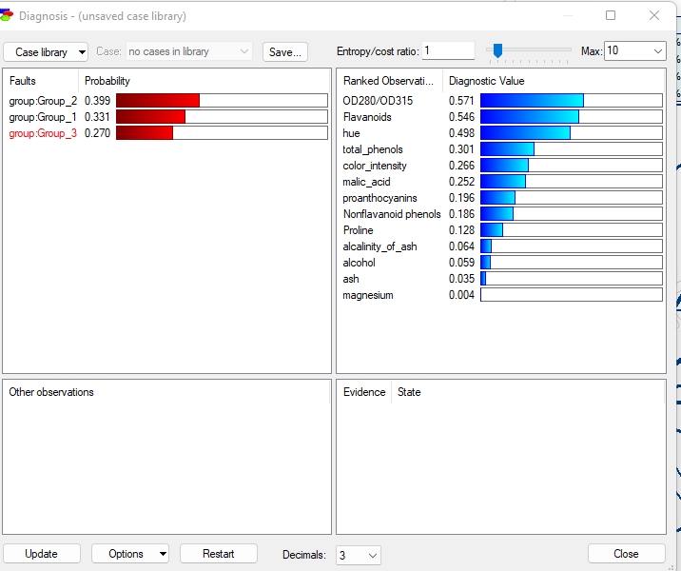
Group 3

Slide 7
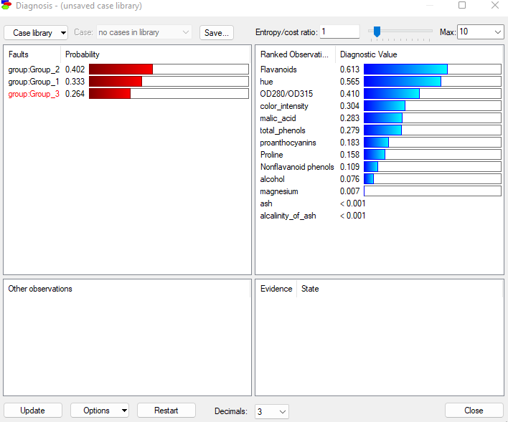
Exception on Group 3 (Bayesian Search Model)

Slide 8
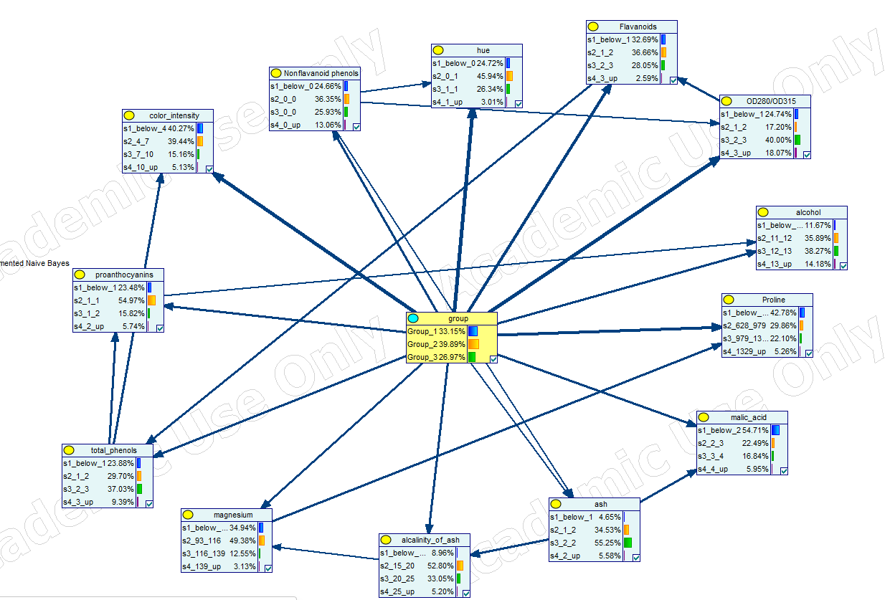
Best Model
TAN

Slide 9

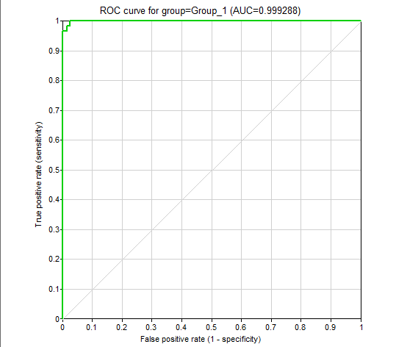

Best Model performance TAN

Slide 10
Conclusion

